Slide 1
Codeflare/
(Ray.io)
Improving the observability of a distributed computing framework
Andy Ma
Mentored by Atin Sood and Professor Turner.
Notes:
Hi I’m andy and I’m here to talk about Codeflare, which is built on top of Ray.io.

Slide 2
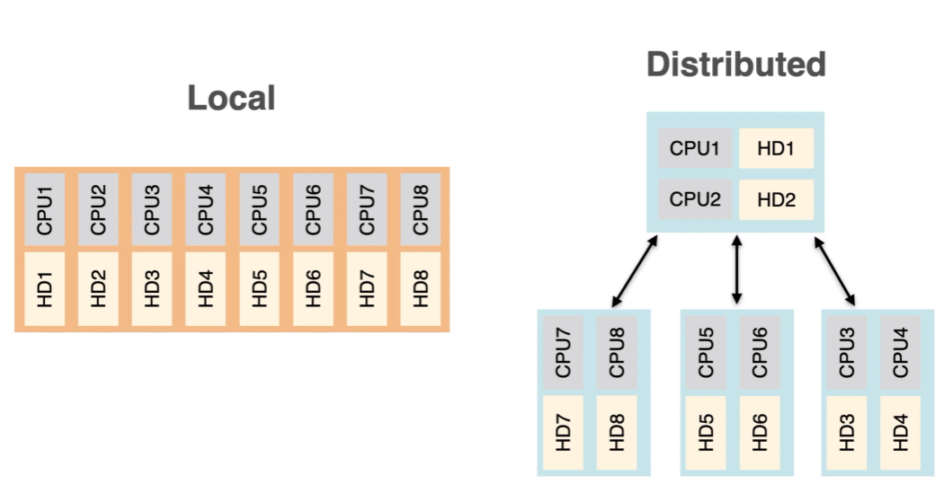
Distributed Computing
They have the same HDs and CPUs
Notes:
First I’d like to talk about… Distributed computing. Which is networked computers working together in parallel to execute a single task or program. The advantages of a distributed system are that they can be scaled up or down based on the complexity of the problem by using more or less workers. But This comes with the cost of synchronization problems which are addressed with networking protocols.

Slide 3
Ray.io (Codeflare)
Machine Learning
Online Learning
Microservices
RAY
RL
High Performance Computing
Big Data
Notes:
Ray (ray.io) is an open-source, distributed framework that easily scales Python applications from a laptop to a cluster. but why create a new a new distributed system if there are already ones that exist?
Complex workloads like Machine Learning, HPC, and Big data are increasingly overlapping. The goal of ray is such a general purpose distributed system that is scalable. Ray is compatible with the python ecosystem (pytorch, tensorflow, numpy etc). And can run on top of AWS, Azure, Kubernetes etc. We want the ability to scare up, without losing functionality
(fun fact: for those of you in op sys:ray uses the tcp protocol for those of you in op sys)

Slide 4

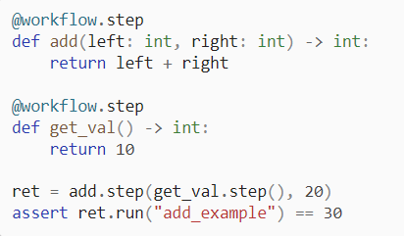
Ray Workflows
Notes:
Ray has many machine learning services, but the folks at Ibm wanted to focus on ray core, which is the main, distributed computing framework.
By annotating your functions and classes you can enable them to run on a cluster.
Regular ray tasks will execute and return an Object reference as soon as the task is called. Workflows allow you to designate which tasks need to be run as a “step” and then you can call .run on the Workflow Object reference to run the entire workflow. This is more efficient and allows for more control for when tasks are executed
(for those of you in op sys:ray uses the tcp protocol for those of you in op sys)

Slide 5
Observability
Notes:
A problem that my mentor, Atin, noticed was the lack of observability for workflows. There is data about if each step is done and their execution times, but there was no way to really look at an entire workflow as a whole and determine the bottlenecks, which paths were taking longer than others.
What we really wanted to see is a directed graph that shows which steps depend on which other steps and which steps are completed at any given time. This dag can be displayed on a dashboard where each task in the workflow can be monitored.

Slide 6
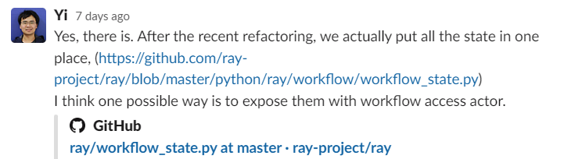
Progress
Some github links.
https://github.com/mobydoby/titanic-with-ray
https://github.com/mobydoby/workflow_dag_project
Notes:
So initially I spent the first month of RCOS understanding ray. Most of that time was spent testing ray functions and reading documentation. For example, I implemented ray in a program where I trained a neural network on the titanic kaggle problem. Around the middle of the semester was when I really had an idea of what I wanted to do with ray. And 2 weeks ago I started to implement the dag. I spoke with Yi Cheng, a developer for Ray on slack and the good news is they have been improving the architecture of ray workflows to allow us to retrieve more meaningful data.
Unfortunately that also means the code I was working on isn’t necessary.

Slide 7

Prospects
Retrieve dag data from Actors
Create pretty graph on the frontend.
Notes:
I would like to continue this project in the fall and hope some of you would consider joining. I am much more familiar with the codebase and can help anyone joining set up the dev environment. the mentor Atin is super helpful. So please join so I wont be… alone … anymore.

